Slide 1
Generation of Computers
Created by
Priya Soni
30/11/2011

Slide 2
Generation of Computers
Computers can be classified into five types according to the generations i.e. time period:
First Generation Computers
Second Generation Computers
Third Generation Computers
Fourth Generation Computers
Fifth Generation Computers

Slide 3
First Generation Computers
Period: 1946-54
Size: Size was equivalent to a room
Language: Machine and Assembly language
Main Component: Vacuum Tubes
Input/output Media: Punched cards & paper tape
Storage Media: Magnetic drum & Magnetic tape

Slide 4
Vacuum tube

Slide 5
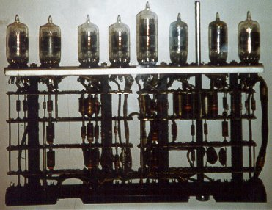
Vacuum tubes

Slide 6
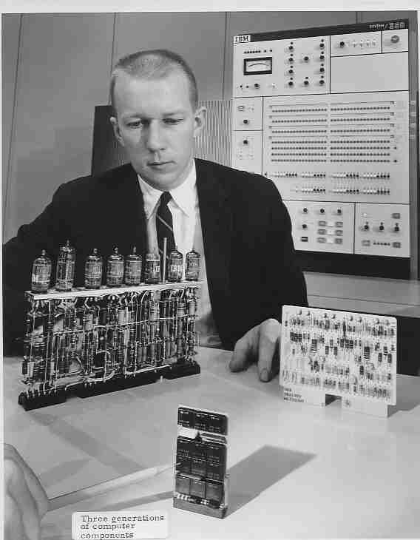
Observing Vacuum tube

Slide 7
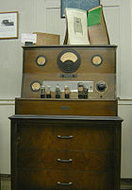
Vacuum tube tester

Slide 8
First Generation Computer
Advantages :
. It was only electronic device
. First device to hold memory
Disadvantages :
. Too bulky i.e. large in size
. Vacuum tubes burn frequently
. They were producing heat
. Maintenance problems

Slide 9
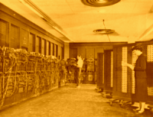
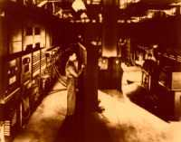
Too bulky i.e. large in size

Slide 10
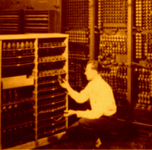
Vacuum tubes burn frequently

Slide 11
Maintenance problems

Slide 12
Second Generation Computers
Period: 1955-64
Size: Smaller than 1st generation
Language: Assembly & high level language
Main Component: Transistors
Input/output Media: Punched cards & printed reports
Storage Media: Magnetic tape & magnetic disk

Slide 13
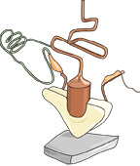
Transistor

Slide 14
Transistor board

Slide 15
Second Generation Computer
Advantages :
. Size reduced considerably
. The very fast
. Very much reliable
Disadvantages :
. They over heated quickly
. Maintenance problems

Slide 16
Third Generation Computers
Period: 1965-74
Size: Disk size mini computers
Language: High level language
Main Component: ICs (Integrated Circuits)
Input/output Media: Key to tape, key to disk & printed reports
Storage Media: Magnetic tape & magnetic disk

Slide 17
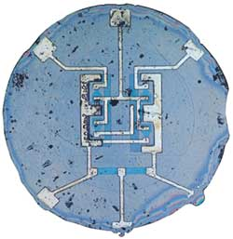
IC (Integrated Circuit)

Slide 18
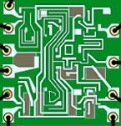
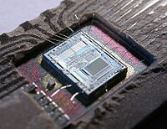
ICs (Integrated Circuits)

Slide 19
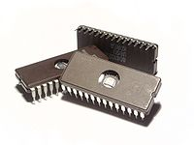
IC (Integrated Circuit)

Slide 20
Third Generation Computer
Advantages :
. ICs are very small in size
. Improved performance
. Production cost cheap
Disadvantages :
. ICs are sophisticated

Slide 21
Fourth Generation Computers
Period: 1975-89
Size: Typewriter size micro computers
Language: High level language
Main Component: ICs with LSI (Large Scale Integration)
Input/output Media: Keyboard data entry, input devices & printed reports
Storage Media: Magnetic disk, floppy & optical disk

Slide 22
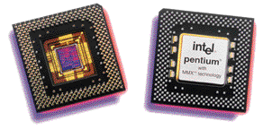
ICs with LSI
(Large Scale Integration)

Slide 23
Fourth Generation Computer
Advantages :
. It is a compact
. Less power consumption
. Production cost is cheap
Disadvantages :
. No artificial intelligent.

Slide 24
Fifth Generation Computers
Period: 1990’s- present & beyond
Size: Credit card size micro computers
Language: Artificial intelligence language
Main Component: SLSI/ULSI
(Super/Ultra Large Scale Integration)
Input/output Media: Tactile inputs, displays
Storage Media: Optical disk & card magnetic disk

Slide 25
Fifth Generation Computer
Advantages :
. Artificial intelligence
. Expert system
. Very low cost

Slide 26
. First generation computer
Vacuum tubes
. Second generation computer
Transistors
. Third generation computer
ICs
. Fourth generation computer
ICs with VLSI
. Fifth generation computer
ICs with parallel processing

Slide 27
Thank You

